Slide 1

Codes for chapter 2

Slide 2
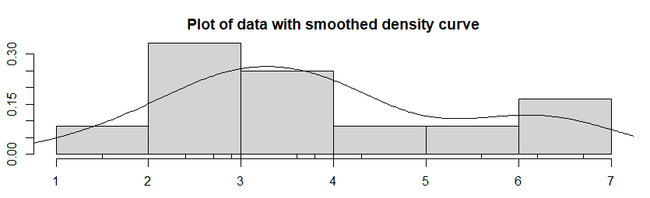
Assessing assumptions using the bootstrap
Page form 70 to 71

Slide 3
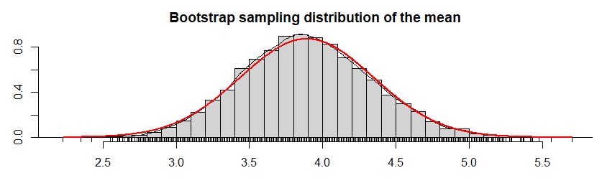

Slide 4
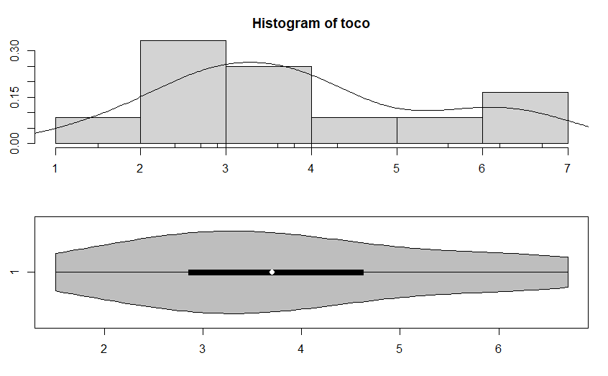
Example: Age at First Transplant
Page form 78 to 81

Slide 5
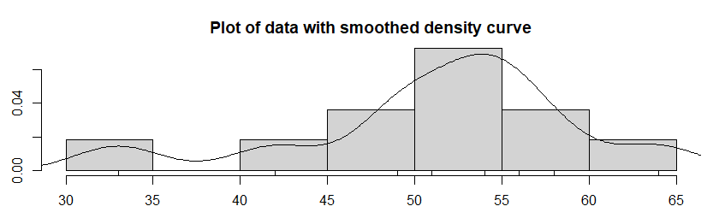

Slide 6
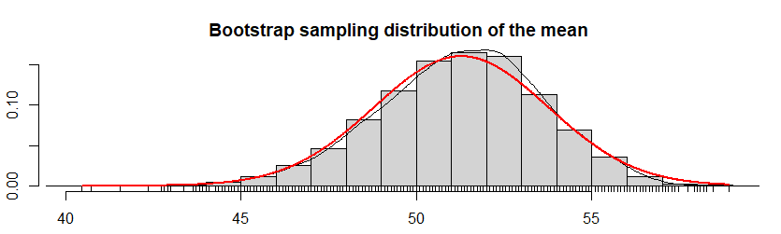

Slide 7
